Slide 1
2023 Senior League Softball World Series
Uniform & Equipment Color Guide

Slide 2
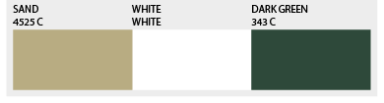
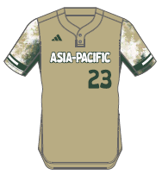
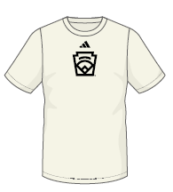
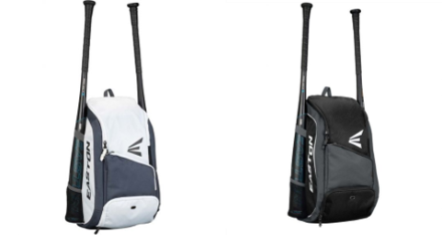

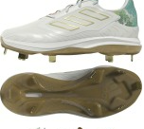
Asia-Pacific
Senior League Softball
Players Should also receive:
Black adidas Softball Pants
Black Socks
Black Belt
Green adidas wristband
Dark Green arm sleeve
Cream adidas base layer shirt
adidas jacket
Easton Bat Backpack
adidas Jersey
adidas Team Shirt
Easton Bat Packs
*Player will receive one or the other
New Era Cap
TPU Metal Cleats

Slide 3
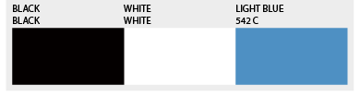
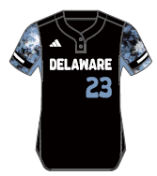

Delaware
Senior League Softball
Players Should also receive:
Black adidas Softball Pants
Black Socks
Black Belt
Cream adidas short sleeve base layer shirt
Black arm sleeve
Black wrist band
Adidas jacket
Easton Bat Backpack
adidas Jersey
adidas Team Shirt
Easton Bat Packs
*Player will receive one or the other
New Era Cap
TPU Metal Cleats

Slide 4
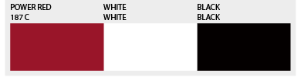
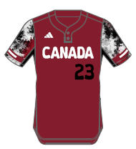

Canada
Senior League Softball
Players Should also receive:
Black adidas Softball Pants
Black Socks
Black Belt
Cream adidas short sleeve base layer shirt
Black arm sleeve
Black wrist band
Adidas Jacket
Easton bat pack
adidas Jersey
adidas Team Shirt
Easton Bat Packs
*Player will receive one or the other
New Era Cap
TPU Metal Cleats

Slide 5
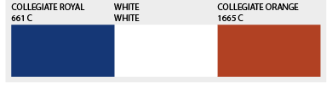
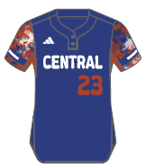
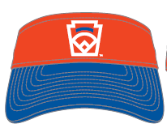
Central
Senior League Softball
Players Should also receive:
Black adidas Softball Pants
Black Socks
Black Belt
Cream adidas short sleeve base layer shirt
Royal arm sleeve
Royal wrist band
Adidas Jacket
Easton bat pack
adidas Jersey
adidas Team Shirt
Easton Bat Packs
*Player will receive one or the other
New Era Cap
TPU Metal Cleats

Slide 6
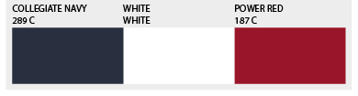
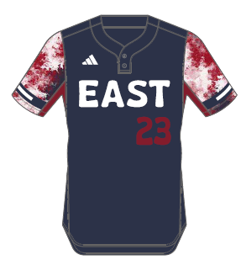
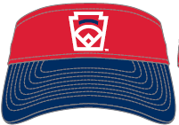
East
Senior League Softball
Players Should also receive:
Black adidas Softball Pants
Black Socks
Black Belt
Cream adidas short sleeve base layer shirt
Red arm sleeve
Red wrist band
Adidas jacket
Easton bat pack
adidas Jersey
adidas Team Shirt
Easton Bat Packs
*Player will receive one or the other
New Era Cap
TPU Metal Cleats

Slide 7
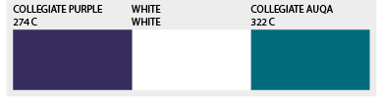
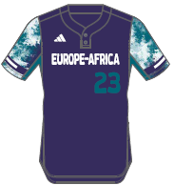

Europe- Africa
Senior League Softball
Players Should also receive:
Black adidas Softball Pants
Black Socks
Black Belt
Cream adidas short sleeve base layer shirt
Purple arm sleeve
Black wrist band
Adidas jacket
Easton bat pack
adidas Jersey
adidas Team Shirt
Easton Bat Packs
*Player will receive one or the other
New Era Cap
TPU Metal Cleats

Slide 8
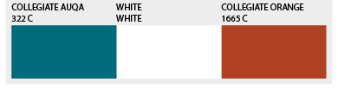
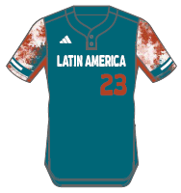

Latin America
Senior League Softball
Players Should also receive:
Black adidas Softball Pants
Black Socks
Black Belt
Cream adidas short sleeve base layer shirt
Black arm sleeve
Orange wrist band
Adidas jacket
Easton bat pack
adidas Team Shirt
adidas Jersey
Easton Bat Packs
*Player will receive one or the other
New Era Cap
TPU Metal Cleats

Slide 9
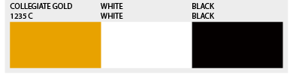
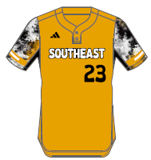

Southeast
Senior League Softball
Players Should also receive:
Black adidas Softball Pants
Black Socks
Black Belt
Cream adidas short sleeve base layer shirt
Black arm sleeve
Black wrist band
Adidas jacket
Easton bat pack
adidas Jersey
adidas Team Shirt
Easton Bat Packs
*Player will receive one or the other
New Era Cap
TPU Metal Cleats

Slide 10
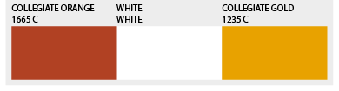
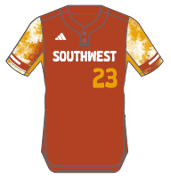

Southwest
Senior League Softball
Players Should also receive:
Black adidas Softball Pants
Black Socks
Black Belt
Cream adidas short sleeve base layer shirt
Black arm sleeve
Orange wrist band
Adidas jacket
Easton bat pack
adidas Jersey
adidas Team Shirt
Easton Bat Packs
*Player will receive one or the other
New Era Cap
TPU Metal Cleats

Slide 11
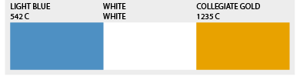
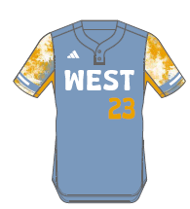

West
Senior League Softball
Players Should also receive:
Black adidas Softball Pants
Black Socks
Black Belt
Cream adidas short sleeve base layer shirt
Black arm sleeve
Black arm sleeve
Adidas jacket
Easton bat pack
adidas Jersey
adidas Team Shirt
Easton Bat Packs
*Player will receive one or the other
New Era Cap
TPU Metal Cleats

