Slide 1
2023 Little League Softball® World Series
Uniform & Equipment Color Guide

Slide 2
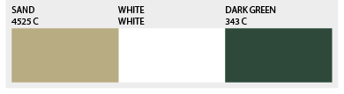
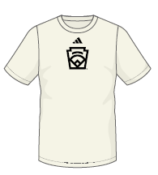
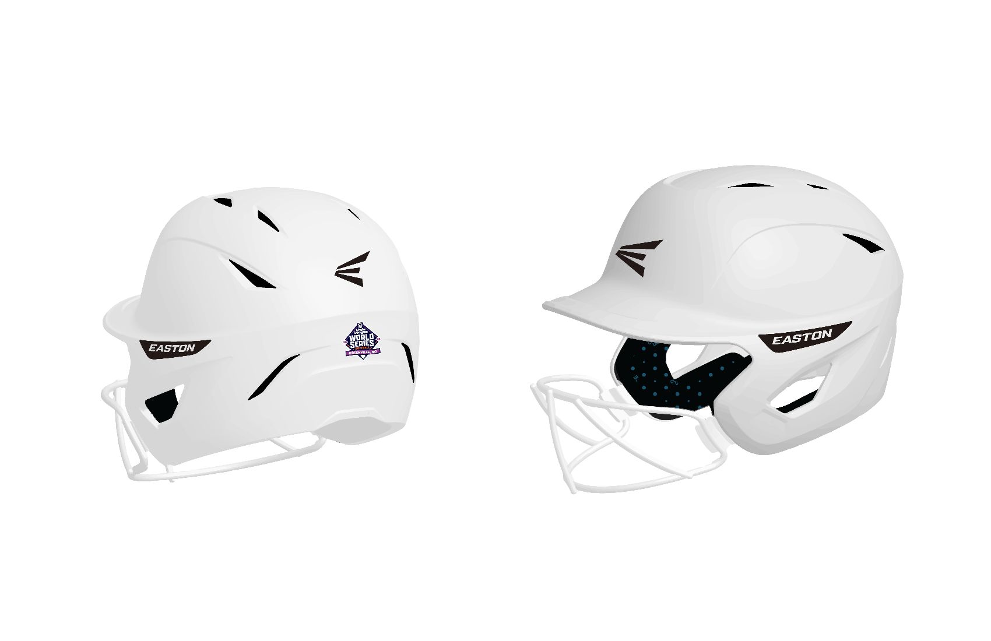
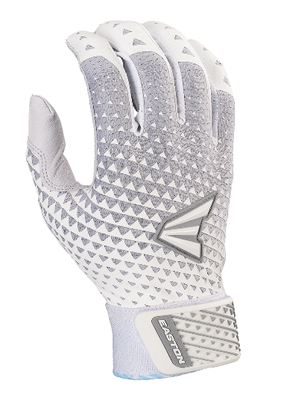
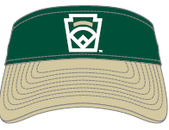
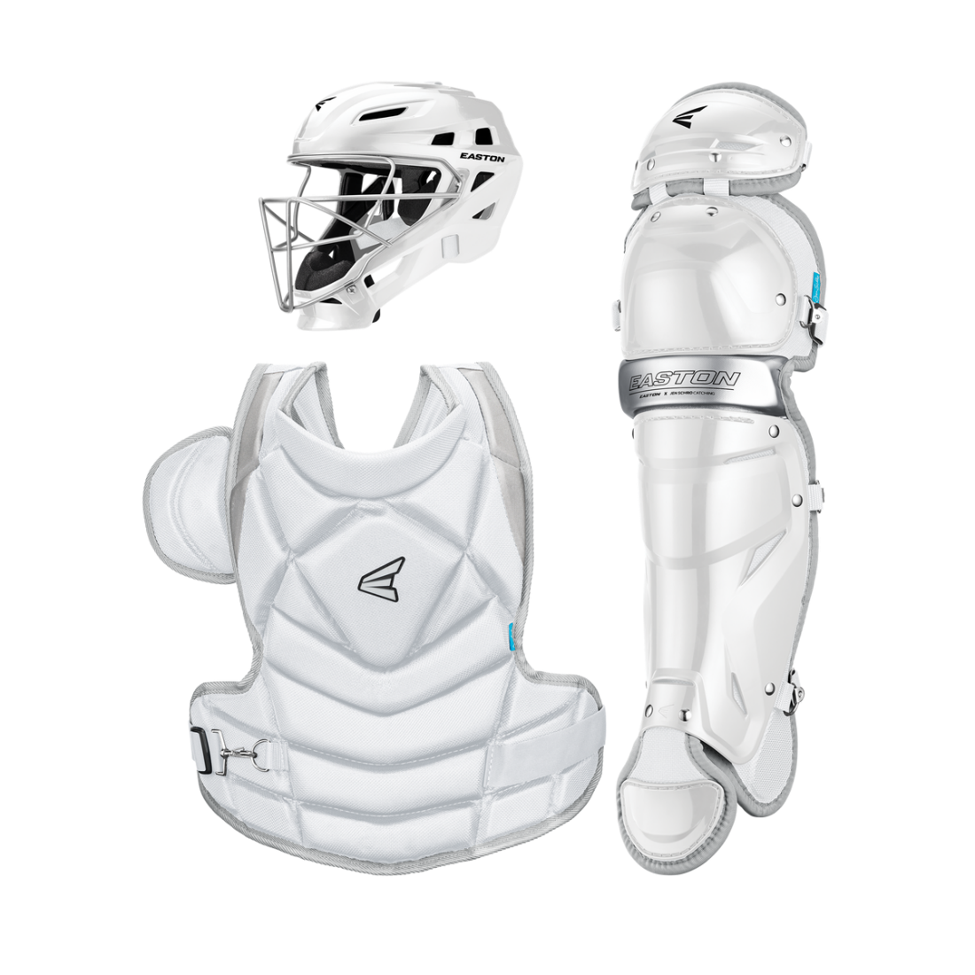
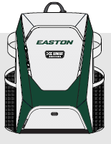
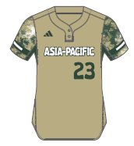
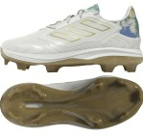
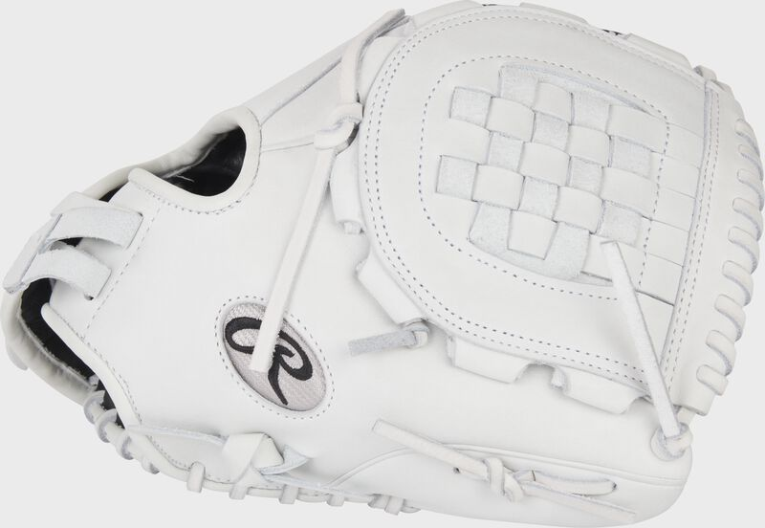
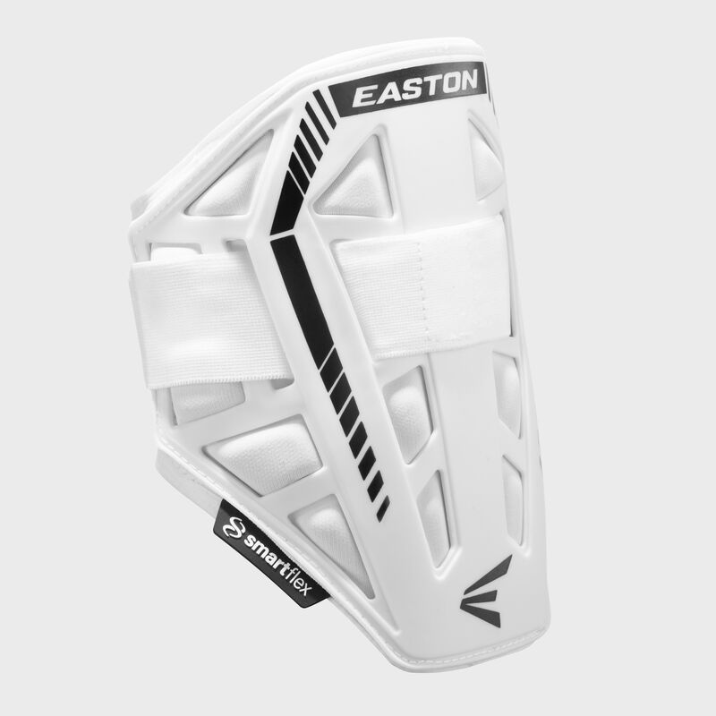
Asia-Pacific
Little League Softball®
Players Should also receive:
Black adidas softball pants
Black Socks
Black Belt
Cream adidas base layer shirt
Dark Green arm sleeve
Dark Green wrist band
adidas jacket
Dark Green Easton Bat Backpack
Easton Helmet
Easton Batting Gloves
New Era Visor
adidas team shirt
Easton Catchers Gear
*2 per team
Bat Pack
TPU
Women’s (Youth/Adult)
Easton
Elbow Guard
adidas Jersey
*LLS receives 23 jerseys per team
Rawlings Liberty
Advanced
Teams will also receive a bat donation from Easton

Slide 3
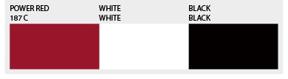
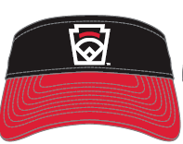
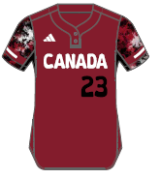
Canada
Little League Softball®
Players Should also receive:
Black adidas softball pants
Black Socks
Black Belt
Cream adidas base layer shirt
Black arm sleeve
Black wrist band
adidas jacket
Red Easton Bat Backpack
Easton Helmet
Easton Batting Gloves
New Era Visor
adidas team shirt
Easton Catchers Gear
*2 per team
Bat Pack
TPU
Women’s (Youth/Adult)
Easton
Elbow Guard
adidas Jersey
*LLS receives 23 jerseys per team
Rawlings Liberty
Advanced
Teams will also receive a bat donation from Easton

Slide 4
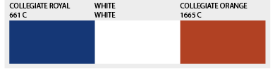
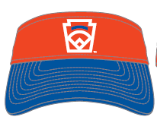
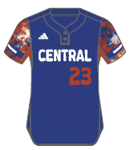
Central
Little League Softball®
Players Should also receive:
Black adidas softball pants
Black Socks
Black Belt
Cream adidas base layer shirt
Royal arm sleeve
Royal wrist band
adidas jacket
Royal Easton Bat Backpack
Easton Helmet
Easton Batting Gloves
New Era Visor
adidas team shirt
Easton Catchers Gear
*2 per team
Bat Pack
TPU
Women’s (Youth/Adult)
Easton
Elbow Guard
adidas Jersey
*LLS receives 23 jerseys per team
Rawlings Liberty
Advanced
Teams will also receive a bat donation from Easton

Slide 5
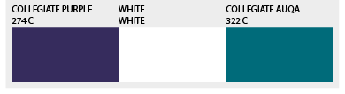
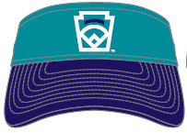
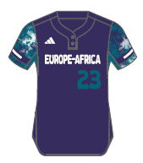
Europe-Africa
Little League Softball®
Players Should also receive:
Black adidas softball pants
Black Socks
Black Belt
Cream adidas base layer shirt
Purple arm sleeve
Black wrist band
adidas jacket
Aqua Easton Bat Backpack
Easton Helmet
Easton Batting Gloves
New Era Visor
adidas team shirt
Easton Catchers Gear
*2 per team
Bat Pack
TPU
Women’s (Youth/Adult)
Easton
Elbow Guard
adidas Jersey
*LLS receives 23 jerseys per team
Rawlings Liberty
Advanced
Teams will also receive a bat donation from Easton

Slide 6
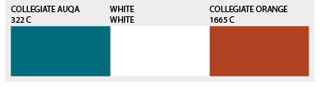
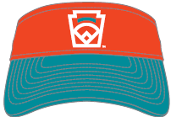
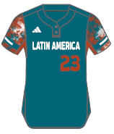
Latin America
Little League Softball®
Players Should also receive:
Black adidas softball pants
Black Socks
Black Belt
Cream adidas base layer shirt
Black arm sleeve
Orange wrist band
adidas jacket
Orange Easton Bat Backpack
Easton Helmet
Easton Batting Gloves
New Era Visor
adidas team shirt
Easton Catchers Gear
*2 per team
Bat Pack
TPU
Women’s (Youth/Adult)
Easton
Elbow Guard
Rawlings Liberty
Advanced
adidas Jersey
*LLS receives 23 jerseys per team
Teams will also receive a bat donation from Easton

Slide 7
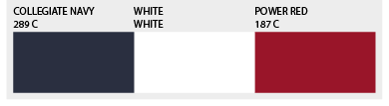
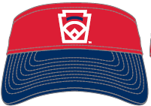
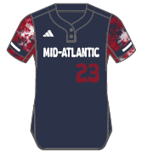
Mid-Atlantic
Little League Softball®
Players Should also receive:
Black adidas softball pants
Black Socks
Black Belt
Cream adidas base layer shirt
Red arm sleeve
Red wrist band
adidas jacket
Red Easton Bat Backpack
Easton Helmet
Easton Batting Gloves
New Era Visor
adidas team shirt
Easton Catchers Gear
*2 per team
Bat Pack
TPU
Women’s (Youth/Adult)
Easton
Elbow Guard
Rawlings Liberty
Advanced
adidas Jersey
*LLS receives 23 jerseys per team
Teams will also receive a bat donation from Easton

Slide 8
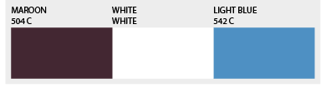
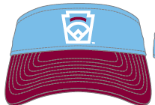
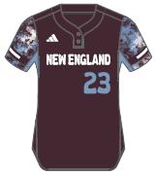
New England
Little League Softball®
Players Should also receive:
Black adidas softball pants
Black Socks
Black Belt
Cream adidas base layer shirt
Black arm sleeve
Black wrist band
adidas jacket
Maroon Easton Bat Backpack
Easton Helmet
Easton Batting Gloves
New Era Visor
adidas team shirt
Easton Catchers Gear
*2 per team
Bat Pack
TPU
Women’s (Youth/Adult)
Easton
Elbow Guard
Rawlings Liberty
Advanced
adidas Jersey
*LLS receives 23 jerseys per team
Teams will also receive a bat donation from Easton

Slide 9
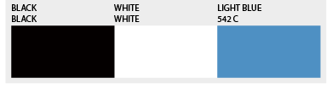
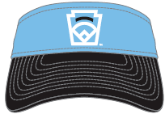
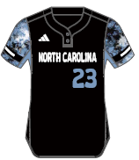
North Carolina
Little League Softball®
Players Should also receive:
Black adidas softball pants
Black Socks
Black Belt
Cream adidas base layer shirt
Black arm sleeve
Black wrist band
adidas jacket
Black Easton Bat Backpack
Easton Helmet
Easton Batting Gloves
New Era Visor
adidas team shirt
Easton Catchers Gear
*2 per team
Bat Pack
TPU
Women’s (Youth/Adult)
Easton
Elbow Guard
Rawlings Liberty
Advanced
adidas Jersey
*LLS receives 23 jerseys per team
Teams will also receive a bat donation from Easton

Slide 10
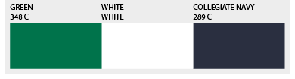
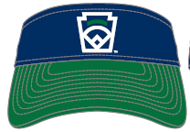
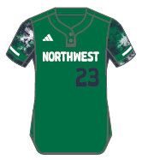
Northwest
Little League Softball®
Players Should also receive:
Black adidas softball pants
Black Socks
Black Belt
Cream adidas base layer shirt
Dark Green arm sleeve
Dark Green wrist band
adidas jacket
Navy Easton Bat Backpack
Easton Helmet
Easton Batting Gloves
New Era Visor
adidas team shirt
Easton Catchers Gear
*2 per team
Bat Pack
TPU
Women’s (Youth/Adult)
Easton
Elbow Guard
Rawlings Liberty
Advanced
adidas Jersey
*LLS receives 23 jerseys per team
Teams will also receive a bat donation from Easton

Slide 11
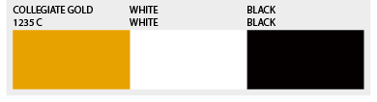
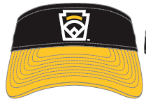
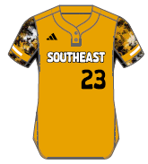
Southeast
Little League Softball®
Players Should also receive:
Black adidas softball pants
Black Socks
Black Belt
Cream adidas base layer shirt
Black arm sleeve
Black wrist band
adidas jacket
Black Easton Bat Backpack
Easton Helmet
Easton Batting Gloves
New Era Visor
adidas team shirt
Easton Catchers Gear
*2 per team
Bat Pack
TPU
Women’s (Youth/Adult)
Easton
Elbow Guard
Rawlings Liberty
Advanced
adidas Jersey
*LLS receives 23 jerseys per team
Teams will also receive a bat donation from Easton

Slide 12
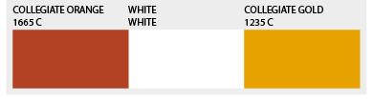
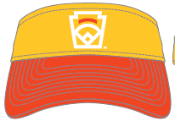
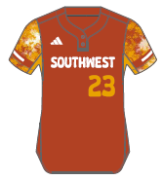
Southwest
Little League Softball®
Players Should also receive:
Black adidas softball pants
Black Socks
Black Belt
Cream adidas base layer shirt
Black arm sleeve
Orange wrist band
adidas jacket
Orange Easton Bat Backpack
Easton Helmet
Easton Batting Gloves
New Era Visor
adidas team shirt
Easton Catchers Gear
*2 per team
Bat Pack
TPU
Women’s (Youth/Adult)
Easton
Elbow Guard
Rawlings Liberty
Advanced
adidas Jersey
*LLS receives 23 jerseys per team
Teams will also receive a bat donation from Easton

Slide 13
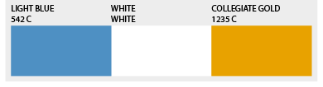
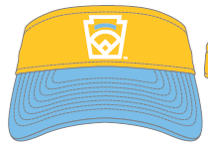
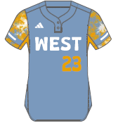
West
Little League Softball®
Players Should also receive:
Black adidas Baseball Pants
Black Socks
Black Belt
Cream adidas base layer shirt
Black arm sleeve
Black wrist band
adidas jacket
White Easton Bat Backpack
Easton Helmet
Easton Batting Gloves
New Era Visor
adidas team shirt
Easton Catchers Gear
*2 per team
Bat Pack
TPU
Women’s (Youth/Adult)
Easton
Elbow Guard
Rawlings Liberty
Advanced
adidas Jersey
*LLS receives 23 jerseys per team
Teams will also receive a bat donation from Easton

Slide 14
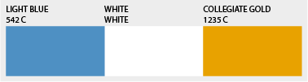
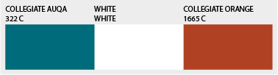
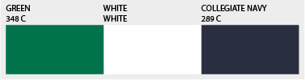







AU Pro Games T-Shirt
Little League Softball®
Latin America
Northwest
West

Slide 15
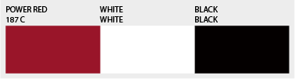
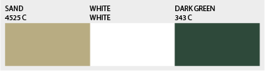
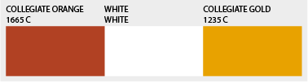






AU Pro Games T-Shirt
Little League Softball®
Asia Pacific
South West
Canada

Slide 16









AU Pro Games T-Shirt
Little League Softball®
Southeast
New England
Mid-Atlantic

Slide 17









AU Pro Games T-Shirt
Little League Softball®
Central
North Carolina
Europe-Africa

