Slide 1
2023 Little League Baseball® World Series
Uniform & Equipment Color Guide

Slide 2
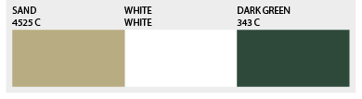
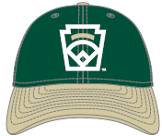
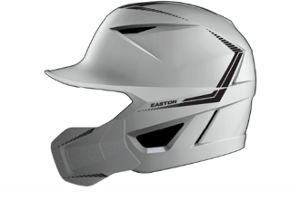
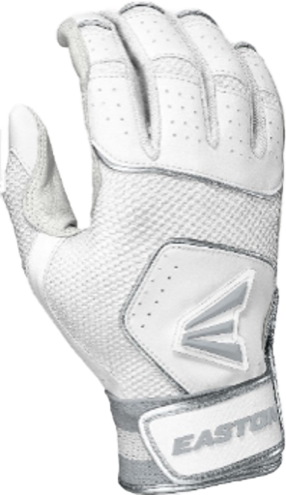
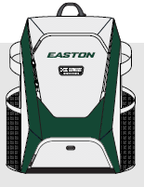
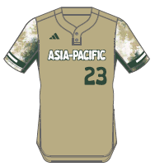
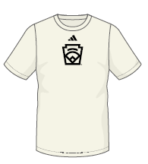
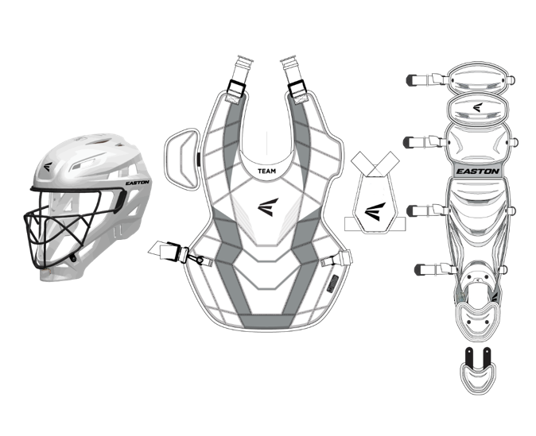
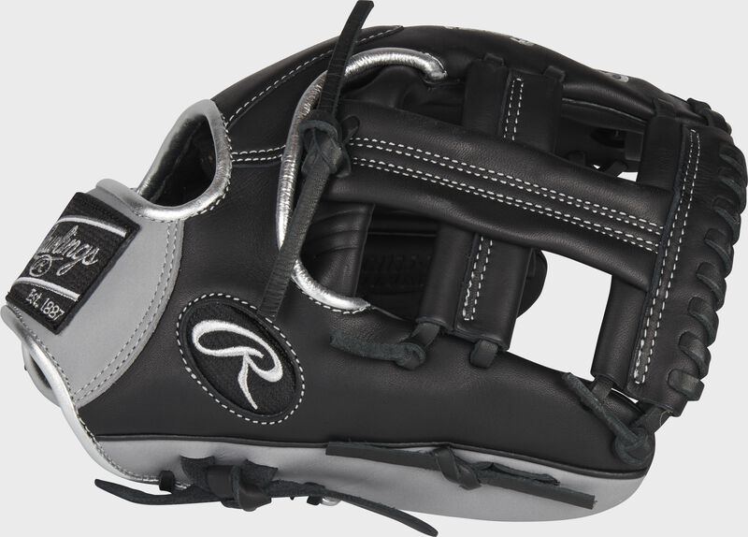
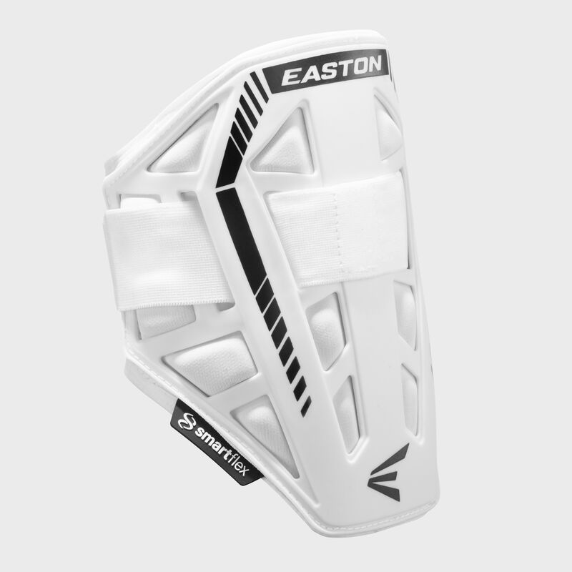

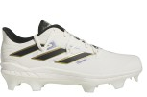
Asia-Pacific
Little League Baseball®
New Era Cap
Players Should also receive:
White adidas Baseball Pants
Dark Green Socks
Dark Green Belt
Dark Green adidas wristband
Dark Green arm sleeve
Cream adidas base layer shirt
adidas jacket
Dark Green Easton Bat Backpack
Easton Helmet
Easton Batting Gloves
Easton Bat Pack
Easton Catchers Gear
*2 per team
Rawlings Encore
adidas Jersey
*LLB receives 21 jerseys per team
adidas Team Shirt
TPU
Youth
TPU
Men’s
Easton Elbow Guard

Slide 3
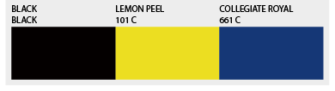
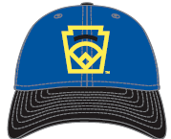
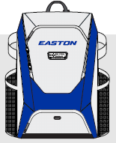
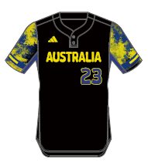
Australia
Little League Baseball®
New Era Cap
Players Should also receive:
White adidas Baseball Pants
Black Socks
Black Belt
Royal adidas wristband
Royal arm sleeve
Cream adidas base layer shirt
adidas jacket
Royal Easton Bat Backpack
Easton Helmet
Easton Batting Gloves
Easton Bat Pack
Easton Catchers Gear
*2 per team
Rawlings Encore
adidas Jersey
*LLB receives 21 jerseys per team
adidas Team Shirt
TPU
Youth
TPU
Men’s
Easton Elbow Guard

Slide 4
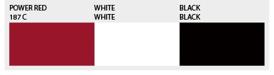
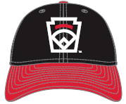
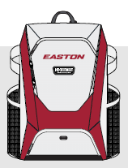
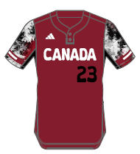
Canada
Little League Baseball®
New Era Cap
Players Should also receive:
White adidas Baseball Pants
Black Socks
Black Belt
Black adidas wristband
Black arm sleeve
Cream adidas base layer shirt
adidas jacket
Red Easton Bat Backpack
Easton Helmet
Easton Batting Gloves
Easton Bat Pack
Easton Catchers Gear
*2 per team
Rawlings Encore
adidas Jersey
*LLB receives 21 jerseys per team
adidas Team Shirt
TPU
Youth
TPU
Men’s
Easton Elbow Guard

Slide 5
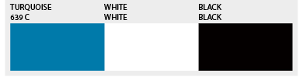
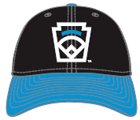
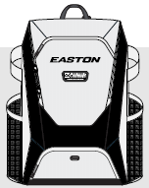
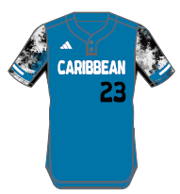
Caribbean
Little League Baseball®
New Era Cap
Players Should also receive:
White adidas Baseball Pants
Black Socks
Black Belt
Black adidas wristband
Black arm sleeve
Cream adidas base layer shirt
adidas jacket
Black Easton Bat Backpack
Easton Helmet
Easton Batting Gloves
Easton Bat Pack
Easton Catchers Gear
*2 per team
Rawlings Encore
adidas Jersey
*LLB receives 21 jerseys per team
adidas Team Shirt
TPU
Youth
TPU
Men’s
Easton Elbow Guard

Slide 6
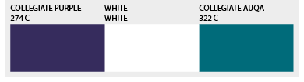
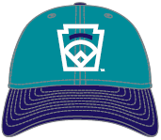
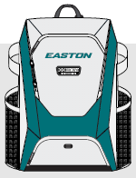
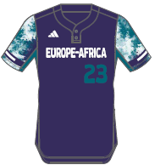
Europe-Africa
Little League Baseball®
New Era Cap
Players Should also receive:
White adidas Baseball Pants
Purple Socks
Purple Belt
Purple adidas wristband
Purple arm sleeve
Cream adidas base layer shirt
adidas jacket
Aqua Easton Bat Backpack
Easton Helmet
Easton Batting Gloves
Easton Bat Pack
Easton Catchers Gear
*2 per team
Rawlings Encore
adidas Jersey
*LLB receives 21 jerseys per team
adidas Team Shirt
TPU
Youth
TPU
Men’s
Easton Elbow Guard

Slide 7
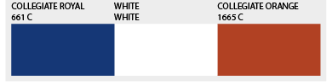
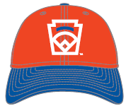
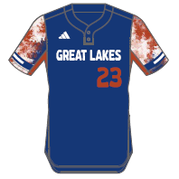
Great Lakes
Little League Baseball®
New Era Cap
Players Should also receive:
White adidas Baseball Pants
Royal Socks
Royal Belt
Royal adidas wristband
Royal arm sleeve
Cream adidas base layer shirt
adidas jacket
Royal Easton Bat Backpack
Easton Helmet
Easton Batting Gloves
Easton Bat Pack
Easton Catchers Gear
*2 per team
Rawlings Encore
adidas Jersey
*LLB receives 21 jerseys per team
adidas Team Shirt
TPU
Youth
TPU
Men’s
Easton Elbow Guard

Slide 8
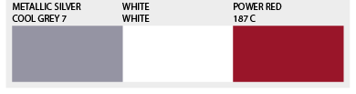
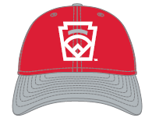
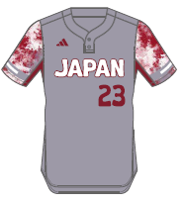
Japan
Little League Baseball®
New Era Cap
Players Should also receive:
White adidas Baseball Pants
Red Socks
Red Belt
Red adidas wristband
Red arm sleeve
Cream adidas base layer shirt
adidas jacket
Red Easton Bat Backpack
Easton Helmet
Easton Batting Gloves
Easton Bat Pack
Easton Catchers Gear
*2 per team
Rawlings Encore
adidas Jersey
*LLB receives 21 jerseys per team
adidas Team Shirt
TPU
Youth
TPU
Men’s
Easton Elbow Guard

Slide 9
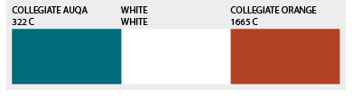
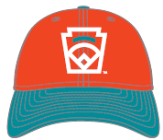
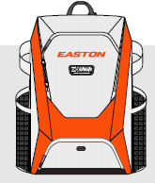
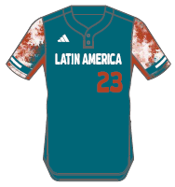
Latin America
Little League Baseball®
New Era Cap
Players Should also receive:
White adidas Baseball Pants
Orange Socks
Orange Belt
Orange adidas wristband
Black arm sleeve
Cream adidas base layer shirt
adidas jacket
Orange Easton Bat Backpack
Easton Helmet
Easton Batting Gloves
Easton Bat Pack
Easton Catchers Gear
*2 per team
Rawlings Encore
adidas Jersey
*LLB receives 21 jerseys per team
adidas Team Shirt
TPU
Youth
TPU
Men’s
Easton Elbow Guard

Slide 10
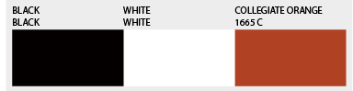
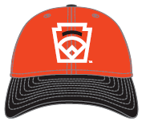
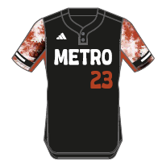
Metro
Little League Baseball®
New Era Cap
Players Should also receive:
White adidas Baseball Pants
Black Socks
Black Belt
Black adidas wristband
Black arm sleeve
Cream adidas base layer shirt
adidas jacket
Orange Easton Bat Backpack
Easton Helmet
Easton Batting Gloves
Easton Bat Pack
Easton Catchers Gear
*2 per team
Rawlings Encore
adidas Jersey
*LLB receives 21 jerseys per team
adidas Team Shirt
TPU
Youth
TPU
Men’s
Easton Elbow Guard

Slide 11
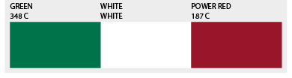
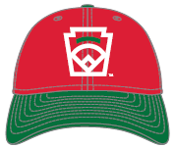
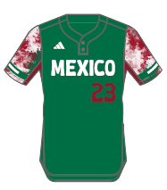
Mexico
Little League Baseball®
New Era Cap
Players Should also receive:
White adidas Baseball Pants
Red Socks
Red Belt
Red adidas wristband
Red arm sleeve
Cream adidas base layer shirt
adidas jacket
Red Easton Bat Backpack
Easton Helmet
Easton Batting Gloves
Easton Bat Pack
Easton Catchers Gear
*2 per team
Rawlings Encore
adidas Jersey
*LLB receives 21 jerseys per team
adidas Team Shirt
TPU
Youth
TPU
Men’s
Easton Elbow Guard

Slide 12
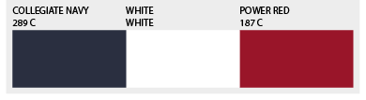
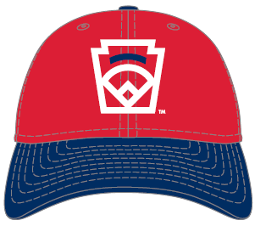
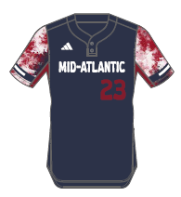
Mid-Atlantic
Little League Baseball®
New Era Cap
Players Should also receive:
White adidas Baseball Pants
Navy Socks
Navy Belt
Red adidas wristband
Red arm sleeve
Cream adidas base layer shirt
adidas jacket
Red Easton Bat Backpack
Easton Helmet
Easton Batting Gloves
Easton Bat Pack
Easton Catchers Gear
*2 per team
Rawlings Encore
adidas Jersey
*LLB receives 21 jerseys per team
adidas Team Shirt
TPU
Youth
TPU
Men’s
Easton Elbow Guard

Slide 13
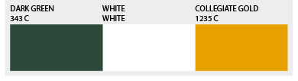
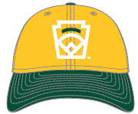
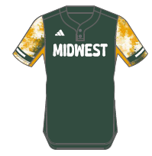
Midwest
Little League Baseball®
New Era Cap
Players Should also receive:
White adidas Baseball Pants
Gold Socks
Gold Belt
Dark Green adidas wristband
Dark Green arm sleeve
Cream adidas base layer shirt
adidas jacket
Dark Green Easton Bat Backpack
Easton Helmet
Easton Batting Gloves
Easton Bat Pack
Easton Catchers Gear
*2 per team
Rawlings Encore
adidas Jersey
*LLB receives 21 jerseys per team
adidas Team Shirt
TPU
Youth
TPU
Men’s
Easton Elbow Guard

Slide 14
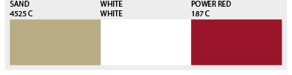


Mountain
Little League Baseball®
New Era Cap
Players Should also receive:
White adidas Baseball Pants
Red Socks
Red Belt
Red adidas wristband
Red arm sleeve
Cream adidas base layer shirt
adidas jacket
Red Easton Bat Backpack
Easton Helmet
Easton Batting Gloves
Easton Bat Pack
Easton Catchers Gear
*2 per team
Rawlings Encore
adidas Jersey
*LLB receives 21 jerseys per team
adidas Team Shirt
TPU
Youth
TPU
Men’s
Easton Elbow Guard

Slide 15




New England
Little League Baseball®
New Era Cap
Players Should also receive:
White adidas Baseball Pants
Maroon Socks
Maroon Belt
Black/Grey adidas wristband
Black arm sleeve
Cream adidas base layer shirt
adidas jacket
Maroon Easton Bat Backpack
Easton Helmet
Easton Batting Gloves
Easton Bat Pack
Easton Catchers Gear
*2 per team
Rawlings Encore
adidas Jersey
*LLB receives 21 jerseys per team
adidas Team Shirt
TPU
Youth
TPU
Men’s
Easton Elbow Guard

Slide 16




Northwest
Little League Baseball®
New Era Cap
Players Should also receive:
White adidas Baseball Pants
Navy Socks
Navy Belt
Dark Green adidas wristband
Dark Green arm sleeve
Cream adidas base layer shirt
adidas jacket
Navy Easton Bat Backpack
Easton Helmet
Easton Batting Gloves
Easton Bat Pack
Easton Catchers Gear
*2 per team
Rawlings Encore
adidas Jersey
*LLB receives 21 jerseys per team
adidas Team Shirt
TPU
Youth
TPU
Men’s
Easton Elbow Guard

Slide 17



Panama
Little League Baseball®
New Era Cap
Players Should also receive:
White adidas Baseball Pants
Red Socks
Red Belt
Grey/Black adidas wristband
Red arm sleeve
Cream adidas base layer shirt
adidas jacket
Red Easton Bat Backpack
Easton Helmet
Easton Batting Gloves
Easton Bat Pack
Easton Catchers Gear
*2 per team
Rawlings Encore
adidas Jersey
*LLB receives 21 jerseys per team
adidas Team Shirt
TPU
Youth
TPU
Men’s
Easton Elbow Guard

Slide 18



Cuba
Little League Baseball®
New Era Cap
Players Should also receive:
White adidas Baseball Pants
Red Socks
Red Belt
Red adidas wristband
Red arm sleeve
Cream adidas base layer shirt
adidas jacket
Red Easton Bat Backpack
Easton Helmet
Easton Batting Gloves
Easton Bat Pack
Easton Catchers Gear
*2 per team
Rawlings Encore
adidas Jersey
*LLB receives 21 jerseys per team
adidas Team Shirt
TPU
Youth
TPU
Men’s
Easton Elbow Guard

Slide 19



Southeast
Little League Baseball®
New Era Cap
Players Should also receive:
White adidas Baseball Pants
Black Socks
Black Belt
Black adidas wristband
Black arm sleeve
Cream adidas base layer shirt
adidas jacket
Black Easton Bat Backpack
Easton Helmet
Easton Batting Gloves
Easton Bat Pack
Easton Catchers Gear
*2 per team
Rawlings Encore
adidas Jersey
*LLB receives 21 jerseys per team
adidas Team Shirt
TPU
Men’s
Easton Elbow Guard
TPU
Youth

Slide 20



Southwest
Little League Baseball®
New Era Cap
Players Should also receive:
White adidas Baseball Pants
Orange Socks
Orange Belt
Orange adidas wristband
Black arm sleeve
Cream adidas base layer shirt
adidas jacket
Orange Easton Bat Backpack
Easton Helmet
Easton Batting Gloves
Easton Bat Pack
Easton Catchers Gear
*2 per team
Rawlings Encore
adidas Jersey
*LLB receives 21 jerseys per team
adidas Team Shirt
TPU
Youth
TPU
Men’s
Easton Elbow Guard

Slide 21




West
Little League Baseball®
New Era Cap
Players Should also receive:
White adidas Baseball Pants
Gold Socks
Gold Belt
Black/Grey adidas wristband
Black arm sleeve
Cream adidas base layer shirt
adidas jacket
White Easton Bat Backpack
Easton Helmet
Easton Batting Gloves
Easton Bat Pack
Easton Catchers Gear
*2 per team
Rawlings Encore
adidas Jersey
*LLB receives 21 jerseys per team
adidas Team Shirt
TPU
Youth
TPU
Men’s
Easton Elbow Guard

Slide 22











MLB Classic T-Shirts
Metro
Little League Baseball®
Australia
West

Slide 23









MLB Classic T-Shirts
Little League Baseball®
Panama
Caribbean
Latin America

Slide 24









MLB Classic T-Shirts
Little League Baseball®
Mexico
Northwest
Canada

Slide 25










MLB Classic T-Shirts
Little League Baseball®
Asia Pacific
Mountain
Cuba

Slide 26









MLB Classic T-Shirts
Little League Baseball®
Southeast
South West
Midwest

Slide 27









MLB Classic T-Shirts
Little League Baseball®
New England
Europe-Africa
Mid-Atlantic

Slide 28








MLB Classic T-Shirts
Little League Baseball®
Great Lakes
Japan

