Slide 1
2023 Junior League Softball World Series
Uniform & Equipment Color Guide

Slide 2
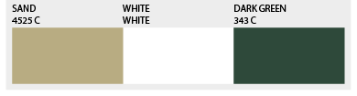
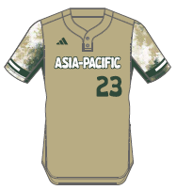
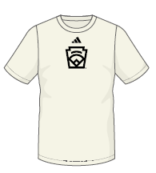
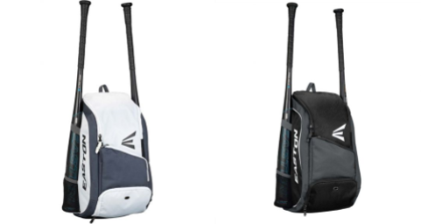
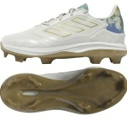

Asia-Pacific
Junior League Softball
Players Should also receive:
Black adidas Softball Pants
Black Socks
Black Belt
Green adidas wristband
Dark Green arm sleeve
Cream adidas base layer shirt
adidas jacket
Easton Bat Backpack
adidas Jersey
adidas Team Shirt
Easton Bat Packs
*Player will receive one or the other
New Era Cap
TPU
‘Women’s/Youth

Slide 3
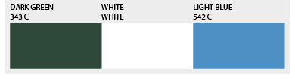
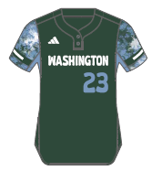

Washington
Junior League Softball
Players Should also receive:
Black adidas Softball Pants
Black Socks
Black Belt
Cream adidas short sleeve base layer shirt
Green arm sleeve
Black wrist band
Adidas jacket
Easton Bat Backpack
adidas Jersey
adidas Team Shirt
Easton Bat Packs
*Player will receive one or the other
New Era Cap
TPU
‘Women’s/Youth

Slide 4
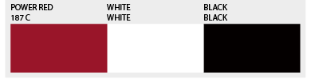
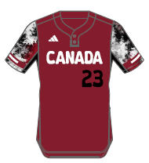

Canada
Junior League Softball
Players Should also receive:
Black adidas Softball Pants
Black Socks
Black Belt
Cream adidas short sleeve base layer shirt
Black arm sleeve
Black wrist band
Adidas Jacket
Easton bat pack
adidas Jersey
adidas Team Shirt
Easton Bat Packs
*Player will receive one or the other
New Era Cap
TPU
‘Women’s/Youth

Slide 5
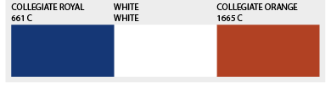
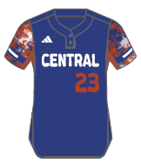
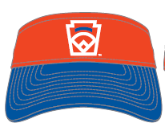
Central
Junior League Softball
Players Should also receive:
Black adidas Softball Pants
Black Socks
Black Belt
Cream adidas short sleeve base layer shirt
Royal arm sleeve
Royal wrist band
Adidas Jacket
Easton bat pack
adidas Jersey
adidas Team Shirt
Easton Bat Packs
*Player will receive one or the other
New Era Cap
TPU
‘Women’s/Youth

Slide 6
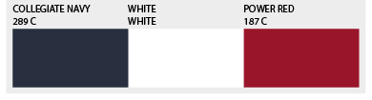
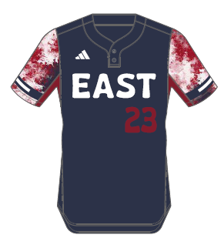
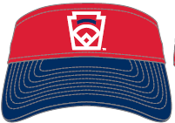
East
Junior League Softball
Players Should also receive:
Black adidas Softball Pants
Black Socks
Black Belt
Cream adidas short sleeve base layer shirt
Red arm sleeve
Red wrist band
Adidas jacket
Easton bat pack
adidas Jersey
adidas Team Shirt
Easton Bat Packs
*Player will receive one or the other
New Era Cap
TPU
‘Women’s/Youth

Slide 7
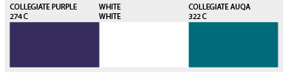
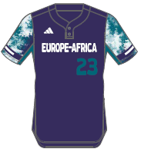
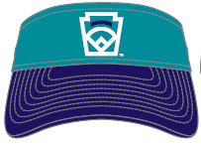
Europe- Africa
Junior League Softball
Players Should also receive:
Black adidas Softball Pants
Black Socks
Black Belt
Cream adidas short sleeve base layer shirt
Purple arm sleeve
Black wrist band
Adidas jacket
Easton bat pack
adidas Jersey
adidas Team Shirt
Easton Bat Packs
*Player will receive one or the other
New Era Cap
TPU
‘Women’s/Youth

Slide 8
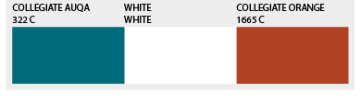
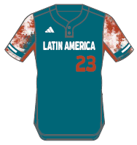
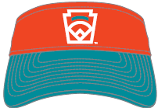
Latin America
Junior League Softball
Players Should also receive:
Black adidas Softball Pants
Black Socks
Black Belt
Cream adidas short sleeve base layer shirt
Black arm sleeve
Orange wrist band
Adidas jacket
Easton bat pack
adidas Team Shirt
adidas Jersey
Easton Bat Packs
*Player will receive one or the other
New Era Cap
TPU
‘Women’s/Youth

Slide 9
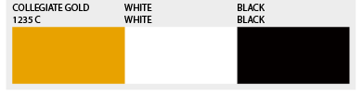
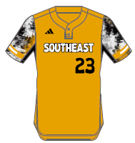

Southeast
Junior League Softball
Players Should also receive:
Black adidas Softball Pants
Black Socks
Black Belt
Cream adidas short sleeve base layer shirt
Black arm sleeve
Black wrist band
Adidas jacket
Easton bat pack
adidas Jersey
adidas Team Shirt
Easton Bat Packs
*Player will receive one or the other
New Era Cap
TPU
‘Women’s/Youth

Slide 10
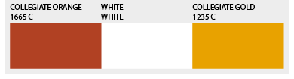
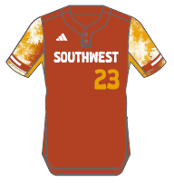
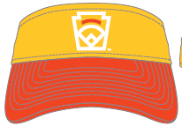
Southwest
Junior League Softball
Players Should also receive:
Black adidas Softball Pants
Black Socks
Black Belt
Orange adidas short sleeve base layer shirt
Black arm sleeve
Orange wrist band
Adidas jacket
Easton bat pack
adidas Jersey
adidas Team Shirt
Easton Bat Packs
*Player will receive one or the other
New Era Cap
TPU
‘Women’s/Youth

Slide 11
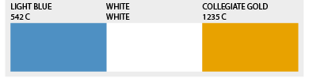
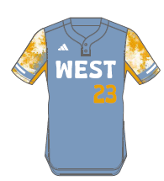

West
Junior League Softball
Players Should also receive:
Black adidas Softball Pants
Black Socks
Black Belt
Cream adidas short sleeve base layer shirt
Black arm sleeve
Black arm sleeve
Adidas jacket
Easton bat pack
adidas Jersey
adidas Team Shirt
Easton Bat Packs
*Player will receive one or the other
New Era Cap
TPU
‘Women’s/Youth

