Slide 1
2023 Junior League Baseball World Series
Uniform & Equipment Color Guide

Slide 2
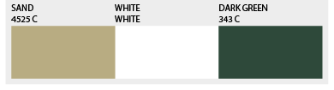
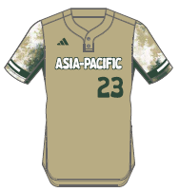
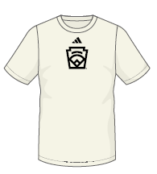
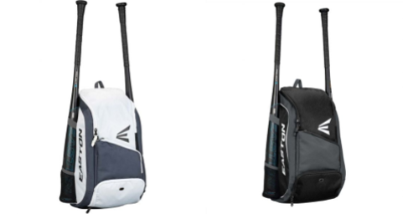
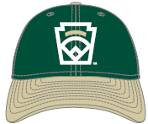
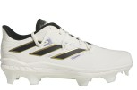

Asia-Pacific
Junior League Baseball
Players Should also receive:
White adidas Baseball Pants
Dark Green Socks
Dark Green Belt
Dark Green adidas wristband
Dark Green arm sleeve
Cream adidas base layer shirt
adidas jacket
Easton Bat Backpack
adidas Jersey
adidas Team Shirt
Easton Bat Packs
*Player will receive one or the other
New Era Cap
TPU (Adult)
TPU (Youth)

Slide 3
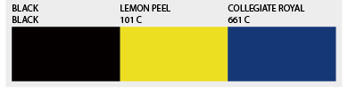
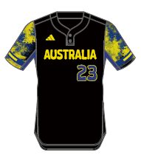
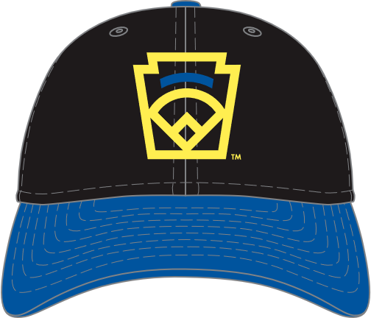
Australia
Junior League Baseball
Players Should also receive:
White adidas Baseball Pants
Black Socks
Black Belt
Black adidas wristband
Royal arm sleeve
Cream adidas base layer shirt
adidas jacket
Easton Bat Backpack
adidas Jersey
adidas Team Shirt
Easton Bat Packs
*Player will receive one or the other
New Era Cap
TPU (Adult)
TPU (Youth)

Slide 4
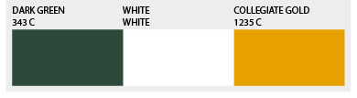
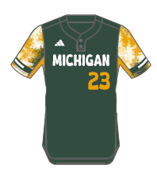
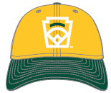
Michigan
Junior League Baseball
Players Should also receive:
White adidas Baseball Pants
Gold Socks
Gold Belt
Cream adidas short sleeve base layer shirt
Green arm sleeve
Green wrist band
Adidas jacket
Easton Bat Backpack
adidas Jersey
adidas Team Shirt
Easton Bat Packs
*Player will receive one or the other
New Era Cap
TPU (Adult)
TPU (Youth)

Slide 5
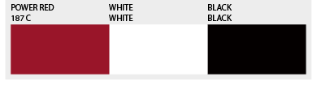
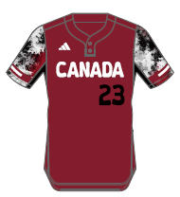
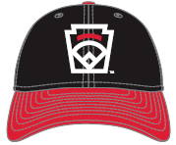
Canada
Junior League Baseball
Players Should also receive:
White adidas Baseball Pants
Black Socks
Black Belt
Cream adidas short sleeve base layer shirt
Black arm sleeve
Black wrist band
Adidas Jacket
Easton bat pack
adidas Jersey
adidas Team Shirt
Easton Bat Packs
*Player will receive one or the other
New Era Cap
TPU (Adult)
TPU (Youth)

Slide 6
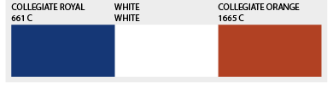
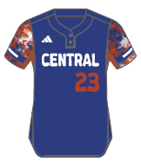
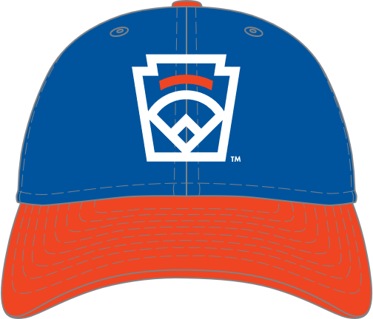
Central
Junior League Baseball
Players Should also receive:
White adidas Baseball Pants
Royal Socks
Royal Belt
Cream adidas short sleeve base layer shirt
Royal arm sleeve
Royal wrist band
Adidas Jacket
Easton bat pack
adidas Jersey
adidas Team Shirt
Easton Bat Packs
*Player will receive one or the other
New Era Cap
TPU (Adult)
TPU (Youth)

Slide 7
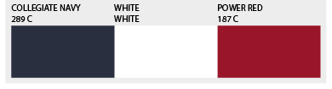
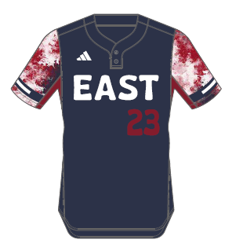
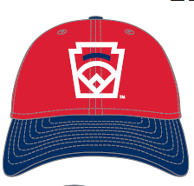
East
Junior League Baseball
Players Should also receive:
White adidas Baseball Pants
Navy Socks
Navy Belt
Cream adidas short sleeve base layer shirt
Red arm sleeve
Red wrist band
Adidas jacket
Easton bat pack
adidas Jersey
adidas Team Shirt
Easton Bat Packs
*Player will receive one or the other
New Era Cap
TPU (Adult)
TPU (Youth)

Slide 8
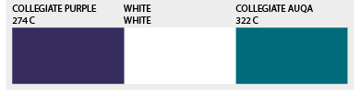
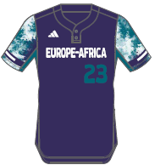
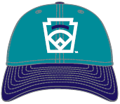
Europe- Africa
Junior League Baseball
Players Should also receive:
White adidas Baseball Pants
Purple Socks
Purple Belt
Cream adidas short sleeve base layer shirt
Purple arm sleeve
Black wrist band
Adidas jacket
Easton bat pack
adidas Jersey
adidas Team Shirt
Easton Bat Packs
*Player will receive one or the other
New Era Cap
TPU (Adult)
TPU (Youth)

Slide 9
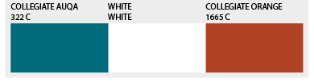
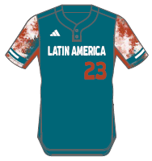
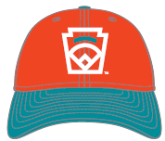
Latin America
Junior League Baseball
Players Should also receive:
White adidas Baseball Pants
Orange Socks
Orange Belt
Cream adidas short sleeve base layer shirt
Black arm sleeve
Orange wrist band
Adidas jacket
Easton bat pack
adidas Team Shirt
adidas Jersey
Easton Bat Packs
*Player will receive one or the other
New Era Cap
TPU (Adult)
TPU (Youth)

Slide 10
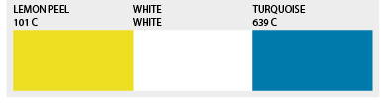
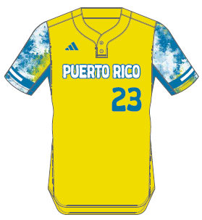

Puerto Rico
Junior League Baseball
Players Should also receive:
White adidas Baseball Pant
Black Socks
Black Belt
Black adidas wristband
Black arm sleeve
Cream adidas base layer shirt
adidas jacket
Easton Bat Backpack
adidas Jersey
adidas Team Shirt
Easton Bat Packs
*Player will receive one or the other
New Era Cap
TPU (Adult)
TPU (Youth)

Slide 11
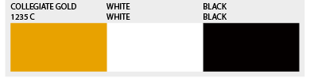
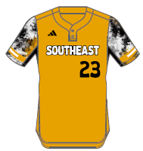
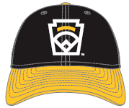
Southeast
Junior League Baseball
Players Should also receive:
White adidas Baseball Pants
Black Socks
Black Belt
Cream adidas short sleeve base layer shirt
Black arm sleeve
Black wrist band
Adidas jacket
Easton bat pack
adidas Jersey
adidas Team Shirt
Easton Bat Packs
*Player will receive one or the other
New Era Cap
TPU (Adult)
TPU (Youth)

Slide 12
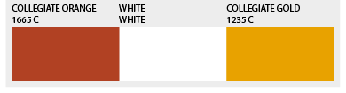
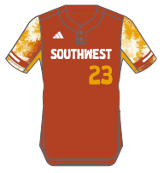
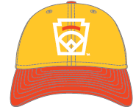
Southwest
Junior League Baseball
Players Should also receive:
White adidas Baseball Pants
Gold Socks
Orange Belt
Cream adidas short sleeve base layer shirt
Black arm sleeve
Orange wrist band
Adidas jacket
Easton bat pack
adidas Jersey
adidas Team Shirt
Easton Bat Packs
*Player will receive one or the other
New Era Cap
TPU (Adult)
TPU (Youth)

Slide 13
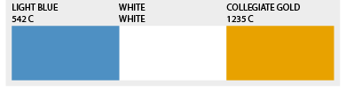
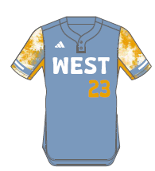
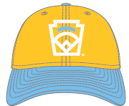
West
Junior League Baseball
Players Should also receive:
White adidas Baseball Pants
Gold Socks
Gold Belt
Cream adidas short sleeve base layer shirt
Black arm sleeve
Black wrist band
Adidas jacket
Easton bat pack
adidas Jersey
adidas Team Shirt
Easton Bat Packs
*Player will receive one or the other
New Era Cap
TPU (Adult)
TPU (Youth)

